Slide 1
MUSIC STORE ANALYSIS
ETL PROJECT
Saif ur Rahman – 000192
S. M. YOUSUF AHMED - 000217
Alisha khan – 000190
Asfandyar -000195

Slide 2
DATASET COLLECTION & OVERVIEW
Dataset is collected from GitHub.
Music Store Dataset Link
This project delves into the sales data of a music store, providing a comprehensive overview of the store's performance over a specific period.
Our analysis aims to uncover key trends, patterns, and insights that can help in making informed decisions to boost sales and enhance customer satisfaction.
we aim to identify the strengths and opportunities by examining various metrics such as sales volume, revenue, and customer behavior.

Slide 3
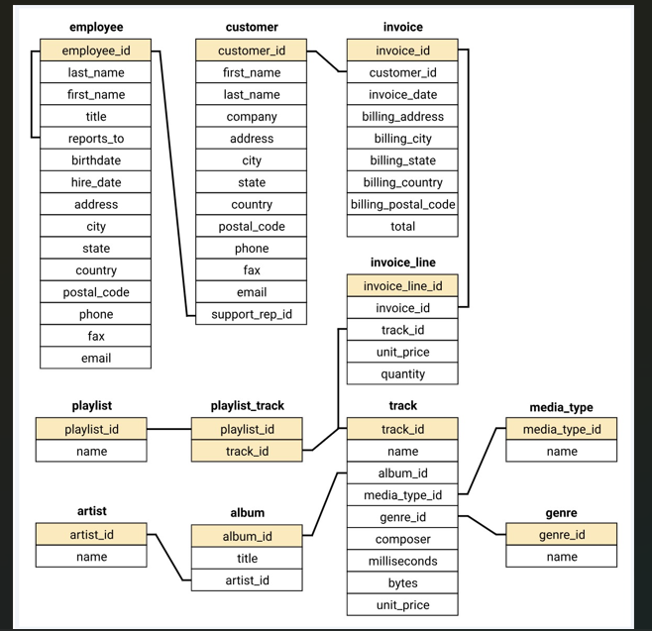
ER DIAGRAM

Slide 4
ER TO STAR SCHEMA
Normalized Data
EDA Queries.
OLTP
ETL
Dimension tables & attributes.
Star schema
OLAP
Data mart.
Fact table.
Insertion queries.

Slide 5
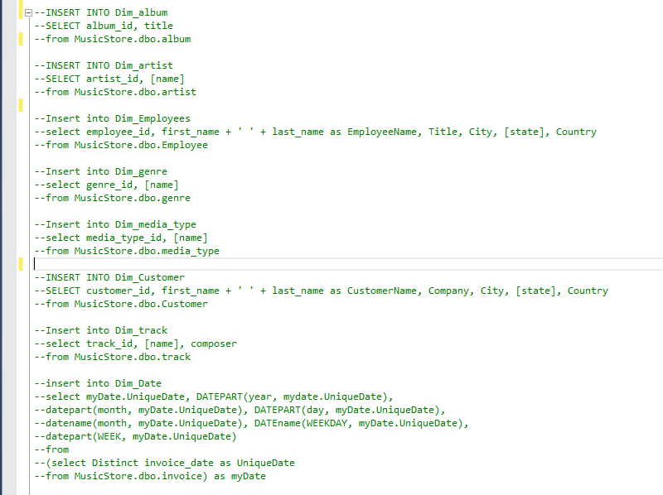
INSERTION QUERIES

Slide 6
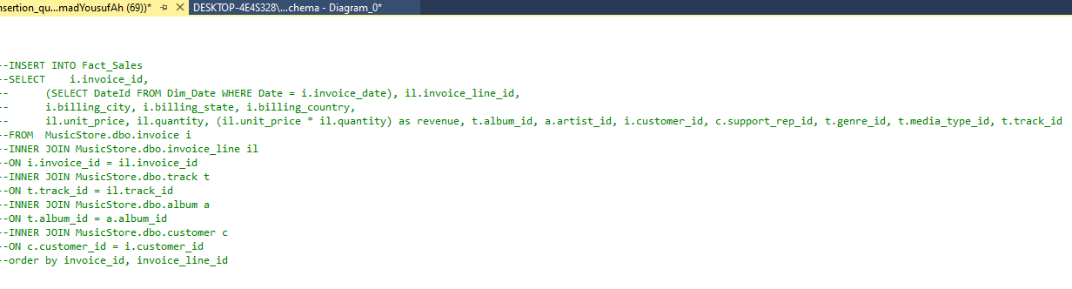
INSERTION QUERIES

Slide 7
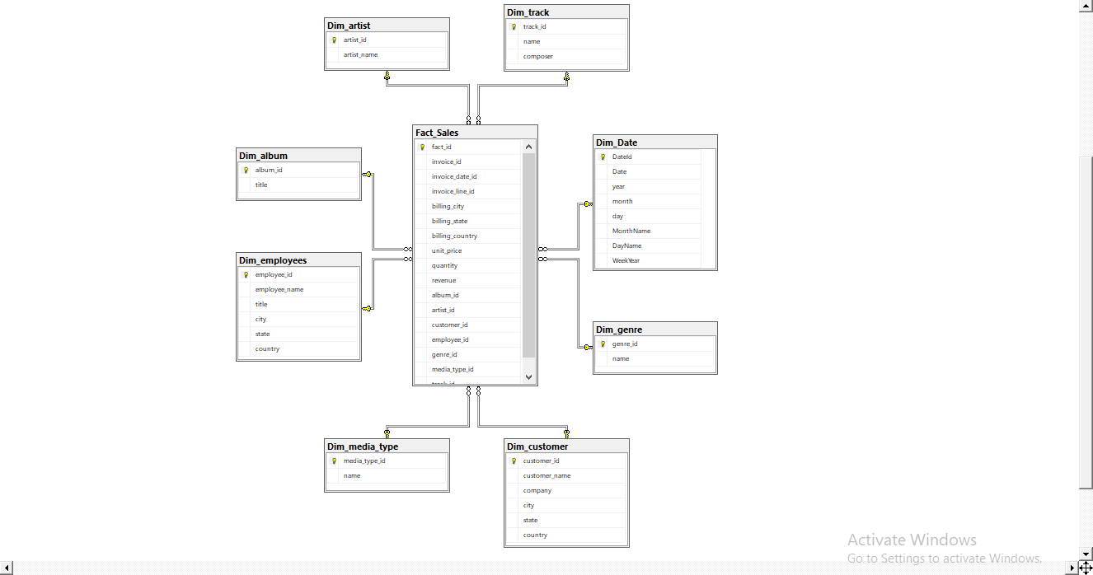
STAR SCHEMA

Slide 8
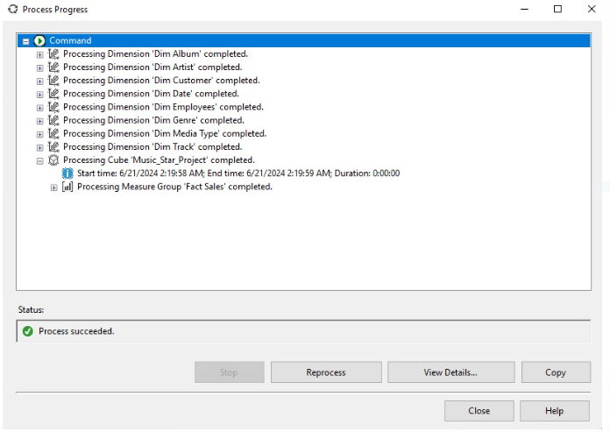
ANALYSIS SERVICES

Slide 9
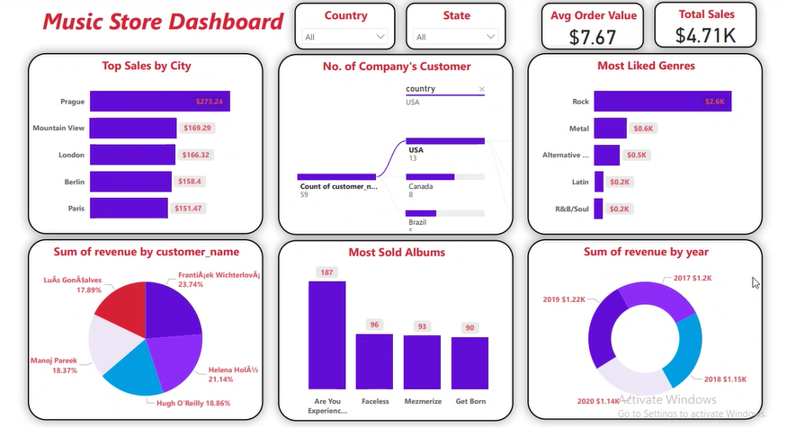
DATA VISUALIZATION - DASHBOARD

Slide 10
THANK-YOU

